Slide 1

Behavioral health impacts of COVID-19
Trends, Workforce Impacts, & Resources
Kira Mauseth, Ph.D.
Behavioral Health Strike Team

Slide 2
Agenda
What to expect from a behavioral health standpoint over the next few months
Developing healthy teams and resilience in the workplace
Understanding impacts to you and your teams
Defining key terms

Slide 3
Definitions
Burnout: Exhaustion of body, mind, and motivation due to exposure to prolonged and unresolved work stress or frustration. Burnout is often a consequence of perceived disparity between the demands of the job and the resources that an employee has available to them.
Compassion fatigue: Emotional and physical exhaustion leading to a diminished ability to empathize or feel compassion for others, also described as secondary traumatic stress.
Moral Injury: Strong feelings of guilt, shame, or anger due to not being able to provide the kind of care or service you want and expect to provide
Resilience: The process – involving behaviors, thoughts, and actions – of adapting well in the face of adversity, trauma, tragedy, threats, or significant sources of stress. Can be developed by focusing on connection, purpose, and flexibility /adaptability.
Resilience factors: Conditions that help a person survive during and recover from a crisis or trauma- usually internal strengths and external resources.

Slide 4
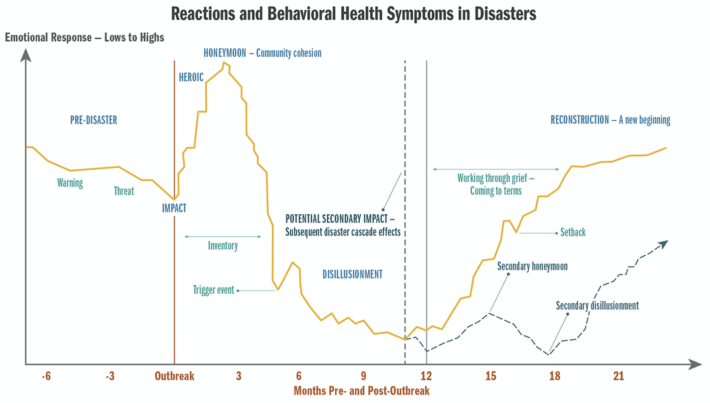

Slide 5
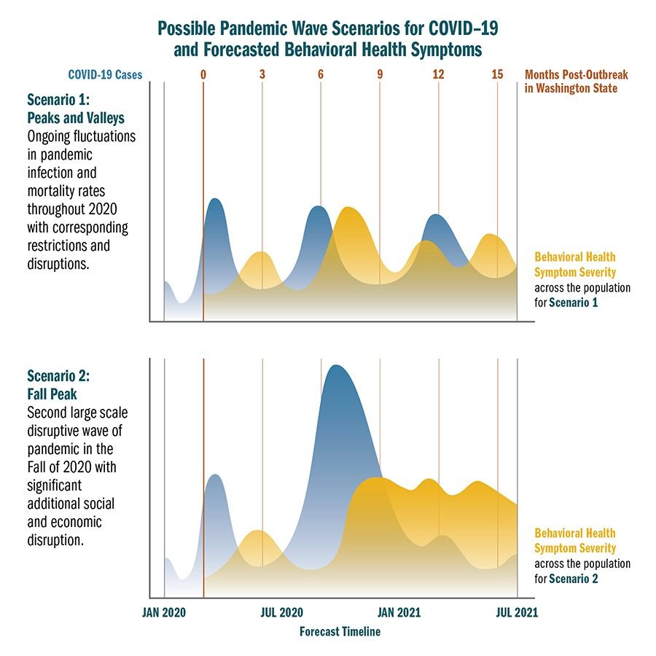

Slide 6
Key Things to Know
Upwards of three million Washingtonians will likely experience clinically significant behavioral health symptoms within the next 2-5 months.
Depression, anxiety, and acute stress will likely be the most common
This number may increase dramatically depending on disease spread
Overlay of stressors: COVID, flu, holidays, Seasonal Affective Disorder, elections, etc.
Substance use related challenges are expected to significantly increase:
Roughly 50% of individuals who experience behavioral health diagnoses develop a substance-related disorder, and vice versa
Most, but not all, are an exacerbation of pre-existing problematic behavior
34% increase in abuse cases in first 6 months of 2020 for youth aged 13-17
Increases in medication errors and accidental misuse for adults over 60

Slide 7
Key Things to Know
Violence and aggression will likely increase due to pandemic impacts
Extreme and/or chronic stressors can leave individuals feeling powerless/loss of control
“Acting-in” or “Acting-out” will subsequently increase, including both self-harm and interpersonal violence
Increase in domestic violence compared to 2019, child abuse also likely increasing
Behavioral health impacts will likely be seen in phases, typically peaking 6-9 months post-outbreak- current data suggest an extended disillusionment phase for COVID pandemic.
Follows the psychological phases of disaster, varies based on start of outbreak and mitigation activities within a community
Normal reaction to abnormal circumstances
Disease activity in the winter will be a strong predictor of behavioral health symptoms well into the spring/summer

Slide 8
Burnout, Compassion Fatigue, Moral Injury, & Exhaustion
Workplace burnout and similar phenomena continues to increase overtime
Compounded by other factors such as mental health stigma, PPE access, and added work
Burnout – exhaustion of body and mind, unequal balance of demands and resources
Compassion Fatigue- emotional/physical tiredness, less ability to empathize
Moral Injury- Strong feelings of guilt, shame, or anger due to not being able to provide the kind of care or service they want and expect to provide
General fatigue, exhaustion, and feeling overwhelmed are common experiences:
Sleep problems, diminished cognitive and high-level thinking, and increased impacts of existing behavioral health symptoms such as depression, anxiety, or trauma
Organizations should address staff wellness and resilience: make it a priority and model it
Practicing self-care, building personal coping/resilience plans, and rest is key for individuals
Notes:
Burnout is defined as exhaustion of body and mind when there is an unequal balance between the demands of the job and the coping resources available to an employee. Compassion fatigue is the emotional and physical tiredness leading to a decreased ability to empathize or feel compassion for others. It is also described as secondary traumatic stress. Moral injury is defined as strong feelings of guilt, shame, and anger about the frustration that comes from not being able to give the kind of care or service that an employee wants and expects to provide.

Slide 9
Recovery vs Return to Baseline
An eventual return to baseline levels of functioning for many people should occur around 14-18 months after the initial outbreak
Assuming rates of infection do not continue to significantly increase, and
A sense of a “new normal” is underway
-OR-
If COVID-19 cases continue to dramatically increase in the fall/winter months, one of the major outcomes will likely be a disaster / trauma cascade
Reduced ability to emotionally recover due to additional/ongoing impacts
  Longer recovery to baseline, impacts lasting longer
  Shift in symptoms: Increase in anxiety and PTSD more likely
Other impacts (economic, social) will also play a role

Slide 10
Anxiety, Depression (Census Bureau)

Slide 11
The Good News
Typical long-term response to disasters is resilience, rather than disorder. Resilience is something that can be intentionally taught, practiced, and developed for people across all groups.
Resilience can be increased by:
Focusing on developing social connections, big or small
Reorienting and developing a sense of purpose
Becoming adaptive and psychologically flexible
Focusing on hope

Slide 12
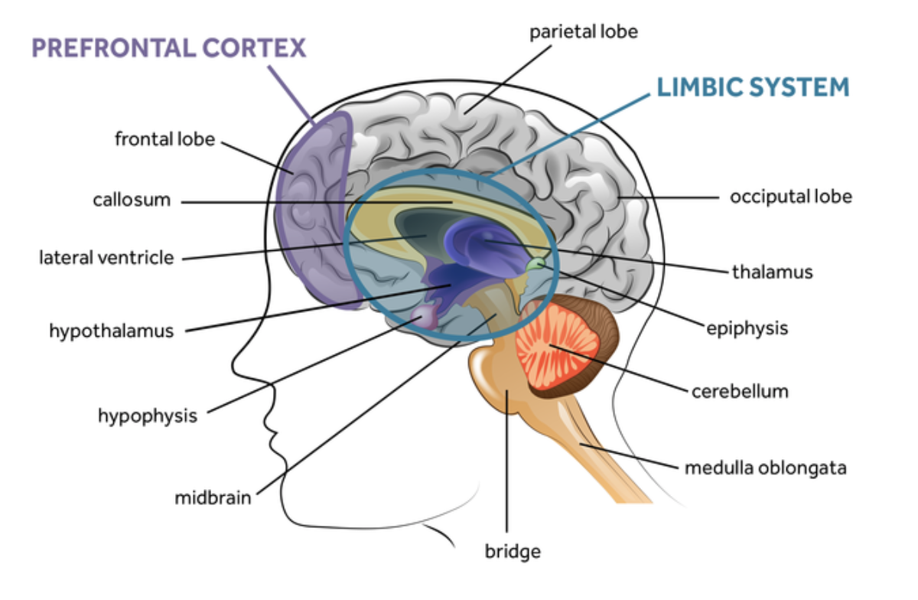

Slide 13
Common Experiences right now:
Easily distracted / trouble focusing
Trouble remembering things
Quick to anger or easily frustrated
Frequent headaches or stomachaches
Trouble falling or staying asleep
Carbs!
Sadness or loneliness (even with all the meetings!)
Information that normalizes the shared experience helps people develop resilience.

Slide 14
Stressed Brains in the Workplace
Potential for increased emotional responses:
  Anger
  Fear
  Frustration
  Less higher-level thinking capacity
  EXHAUSTION

Slide 15
Compassion Fatigue And Job Burnout
Burnout can lead to many harmful consequences, including changes in the way people view:
  Themselves
  Their environment
  Their world
  Their meaning or purpose and
  The future
Other workplace factors that contribute to burnout include:
  When people don’t (or aren’t able to) process the emotional rewards from their work.
  Work where there may be few compassion rewards (The work regularly feels more challenging or draining than rewarding).
  Too few resources and too much personal demand to meet perceived needs or asks.

Slide 16
Opportunities for Supervisors & Managers
Walk the Walk: What is DONE is what matters, not what people are told to do.
Be honest and open in the communication process.
  If you don’t know, tell your team you don’t know.
Active Listening is something that all team members can benefit from learning and practicing.
  Listen with the intention of understanding and caring, NOT to problem solve.

Slide 17
What can we do to reduce burnout generally?
Develop Resilience: Connection, Purpose, Flexibility / Adaptability and Hope.
Hope is about trying to perceive unexpected change not as a “threat” but as a “potential opportunity” and acknowledging that this disaster isn’t going to last forever.
Maintaining and enhancing interpersonal boundaries: Know your limits. Say no to tasks that will take away from your work-life balance. Ask others to help when reaching limits.
Connect with people outside of work or socially within work.

Slide 18
Resilience
Internal Strengths
External Resources
Cooperation and communication
Problem solving
Self-awareness
Empathy
Self-efficacy
Goals and aspirations
What has worked well for you in the past?
Why did that work well?
What resources are still needed?

Slide 19
Resilience Development
Flexibility and Adaptability
Purpose
Connection
How can you be creative in physical distancing while leveraging connection?
How can you adjust your physical space?
How can you adapt your schedule to give yourself discreet and clear breaks and boundaries?
What motivates you?
What contributes to compassion rewards?
What can you remind yourself of to help on a day-to-day basis (don’t think too long term or big picture).
How can you maintain existing connections with others?
How can you develop new connections?
Connection can be anything.

Slide 20
Practice the REST Model
Reward: Reward yourself for a job well done. Build reinforcements into your work. Help pay attention to this aspect for maintaining resilience.
Establish: Establish healthy boundaries. When you are off duty, stick to that boundary.
Share: Share your feelings, concerns, and stories. Participate in support and consultation groups. Make time for connections and activities in your life.
Trust: Trust your support network and reach out as needed. Refer people elsewhere if you are too tired or compromised emotionally to be able to offer support.

Slide 21
Take time off as you can and do things that are entirely NOT work related.
Taking care of yourself takes care of the team and the organization.
Finding ways to reduce burnout NOW is essential. Get outside as much as you can (when safe to do so).
Getting processes in place from the top down (and modeling good self-care) dramatically reduces burnout for team members.

Slide 22
Resources
Training:
Health Support Team (including train-the-trainer)
PsySTART-Responder (frontline healthcare only)
Specific Resources:
Behavioral Health Group Impact Reference Guide
    Healthcare, behavioral health, outreach teams, post-vent
    Unique challenges/considerations
    Support strategies (organizational, supervisory, personal)
Family toolbox:
Supporting Children and Teens During the COVID-19 Pandemic
Emergency and healthcare workers:
Coping During COVID-19 for Emergency and Healthcare Professionals
Businesses and workers:
COVID-19 Guidance for building resilience in the workplace

Slide 23
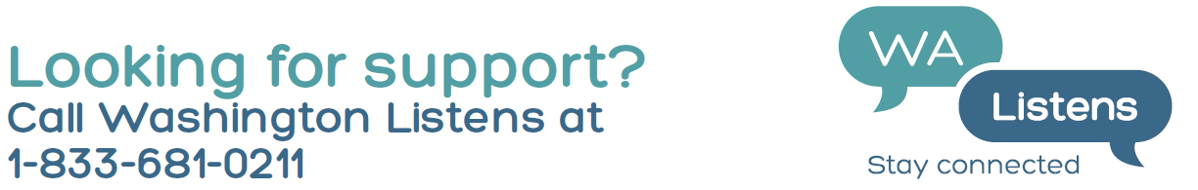
Resources:
DOH - Forecast and situation reports, guidance, and resources:
https://www.doh.wa.gov/Emergencies/NovelCoronavirusOutbreak2020COVID19/HealthcareProviders/BehavioralHealthResources
State – General mental health resources:
https://coronavirus.wa.gov/information-for/you-and-your-family/mental-and-emotional-well-being
Podcast:
https://soundcloud.com/user-718826213/sets/coping-with-covid-behavioral

