Slide 1
What Questions Should Drive Recovery and Rebuilding of the Early Childhood System?

Slide 2
Welcome
Please introduce yourself in the chat box below by including any or all of the following:
Your name
Where do you live (city + state, or equivalent)?
Is there a particular role or viewpoint you are bringing to this conversation?
Share one word that describes how you feel today.

Slide 3
Introductions
Facilitator
NAME
Role + Organization
Facilitator
NAME
Role + Organization
Recorder
NAME
Role + Organization

Slide 4
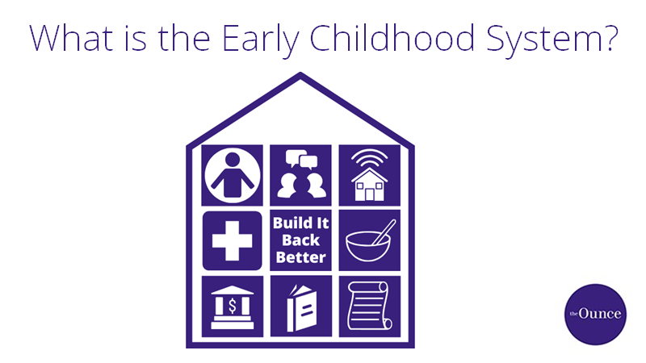
Notes:
Before we get started, let’s take a few minutes to talk about what we think is part of the “early childhood system’?
What do you consider to be part of the early childhood system? If you want any hints, this graphic suggests elements commonly considered key parts of early childhood system.
After a few minutes, summarize responses:
Comprehensive and collaborative, supports development of whole child, food/housing/income security, care and education, policy, health care, libraries and museums, technology, family empowerment and voice, financing…(insert others)

Slide 5
Build It Back Better Goals
To generate critical questions to inform development of a stronger, brighter future for ALL young children and families through realization of a responsive, equitable, and comprehensive early childhood system;
To increase and democratize participation in conversations about how to build the system back better --prioritizing family, practitioner, and community needs;
Facilitate courageous conversations that increase connectivity, cohesion, and inclusion across the system.
Notes:
Over the past several months, both the strengths and shortcomings of the system designed to support the development of young children and their families in the United States have been illuminated by the challenges and dire circumstances created by the COVID-19 pandemic. A disproportionate impact of COVID-19 on communities of color combined with ongoing systemic racism and police brutality have also contributed to a growing social justice movement. Together, as we move through this crisis and collective awakening, the early childhood system –including those most impacted by it – must consider the lessons learned through our challenges, our resilience, and these persistent inequities to determine how we will collectively ensure a stronger, brighter future for ALL young children and those who care for them.
As a first step toward encouraging responsive system evolution, the Ounce of Prevention Fund, as well as many others, are hosting, participating in, and encouraging conversations in service to rebuilding a better, more equitable, and comprehensive early childhood system. We understand how critical an inclusive collection of experiences and ideas is to ensuring we build it back better.

Slide 6
1 Facilitate
+
Host Dialogues
2 Write
+
Share Themes
Build It Back Better
Phase I
3
Expand Discussion Online
4 Produce Report
+
Tools
Notes:
During Phase I of Build It Back Better, the Ounce of Prevention hosted core dialogues with families, practitioners, community leaders, and state/national system leaders to start to generate key questions in service to building back a stronger, more comprehensive early childhood system.
Themes and ideas from our dialogue today will be included in the information being gathered from groups around the country who are impacted by or involved with the early childhood system.
This information will serve as the focus of communication materials and to seed further discussion as a means to including more voices and identifying priorities and key questions as we work collaboratively to recover and rebuild.

Slide 7
Dialogue Questions
1
When you think about your children or the children in your care or community, what is a hope, dream, or goal that you have for them?
2
What are your biggest worries or concerns for your family or the children in your care/community? What keeps you up at night?
3
COVID-19 has clearly highlighted systems challenges in every state and community. How did supports for young children and families respond or fare in your state or community? Who has been disproportionately impacted by these challenges in your state or community?
4
With respect to the challenges, concerns, and inequities, what has or would help to alleviate these issues or make things better?
5
What questions should we all be asking as we think about how to make sure ALL young children and families thrive?
Notes:
Q1: When you think about your children or the children in your care or community, what is a hope, dream, or goal that you have for them?
Q2: What are your biggest worries or concerns for your family or the children in your care/community? What keeps you up at night?
Q3: COVID-19 has clearly highlighted systems challenges in every state and community. How did the supports for young children and families respond or fare in your state or community? Both positive and negative experiences are helpful to share. Who has been disproportionately impacted by these challenges in your state or community?
Q4: With respect to the challenges, concerns, and inequities, what has or would help to alleviate these issues or make things better? This could be at any level (family, program, community, or policy).
Q5: What questions should we all be asking as we think about how to make sure ALL young children and families thrive?

Slide 8
Dialogue
When you think about your children or the children in your care or community, what is a hope, dream, or goal that you have for them?
Q1

Slide 9
Dialogue
What are your biggest worries or concerns for your family or the children in your care/community? What keeps you up at night?
Q2

Slide 10
Dialogue
COVID-19 has clearly highlighted systems challenges in every state and community. How did supports for young children and families respond or fare in your state or community? Who has been disproportionately impacted by these challenges in your state or community?
Q3

Slide 11
Dialogue
With respect to challenges, concerns, or inequities, what has or would help to alleviate these issues or make things better?
Q4

Slide 12
Dialogue
What questions should we all be asking as we think about how to make sure ALL young children and families thrive?
Q5

Slide 13
Build It Back Better
Partnership Opportunities
Host a dialogue of your own!
Join ECConnector.org to stay involved in efforts to Build It Back Better!
Notes:
The more voices talking about these issues, the stronger the resulting system will be. Who do you know who should be part of this conversation? Consider hosting your own dialogue or inviting others to join the conversation online.
Please continue being part of the conversation, as well as access resources to host your own dialogue, by creating a free account on the Early Childhood Connector (ECConnector.org).
Join thousands of others who care about early childhood and who are learning from and connecting with each other at ECConnector.org!

